Slide 1
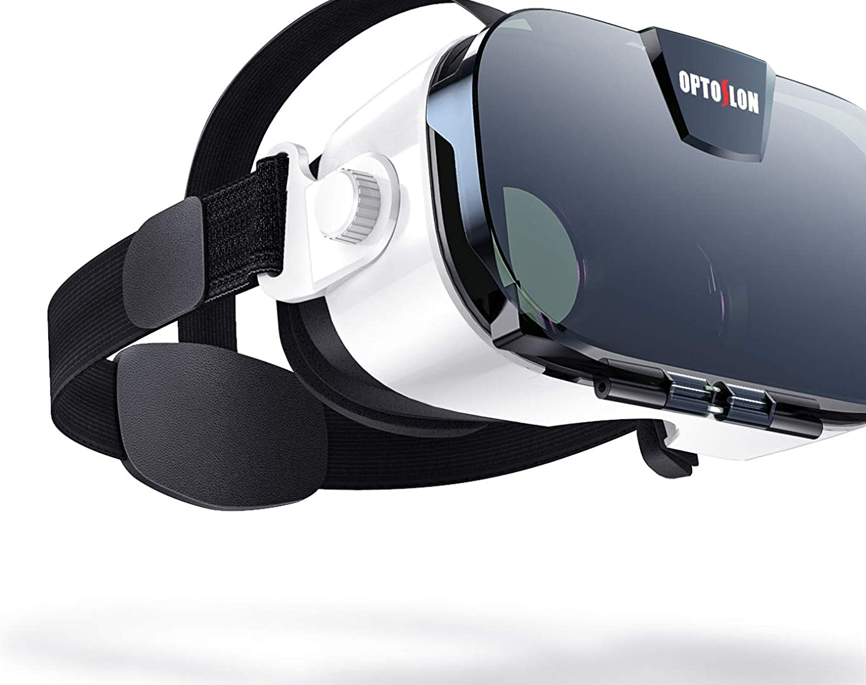
VR meeting
Tanghinian
2021 VTC STEM Challenge Cup

Slide 2

Preface
During the pandemic, we need to have lessons online. The school seems far away from us and we cannot participate in some classes such as laboratory lessons. Therefore, we decided to make a VR class system to improve the situation.

Slide 3
Method of 3D lesson creation
Creating 3D lessons is a complex undertaking. We are going to make a model of 3D teachers in real time and send to the client side using 5G network.
The client side will process the 2D graphic and output it to the screen. Students can control the view as in 3D video games in order to see the teaching environment realistically and clearly.

Slide 4
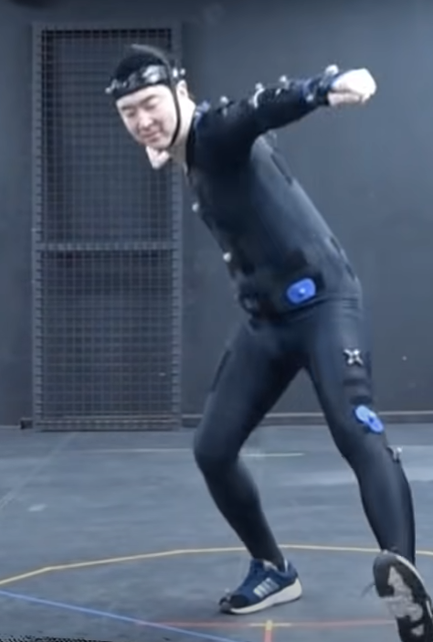
3D motion detector (spandex bodysuit type)
With around 10 motion recording sensors and a spandex bodysuit with coordinate recording sensors , we can also record the motion. This kind of method is extensively used in 3D movies/video making, 3D games making, and intangible cultural heritage protecting (e.g. Folk dancing). This can help to record the detailed action of the teacher, such as hand movements.

Slide 5
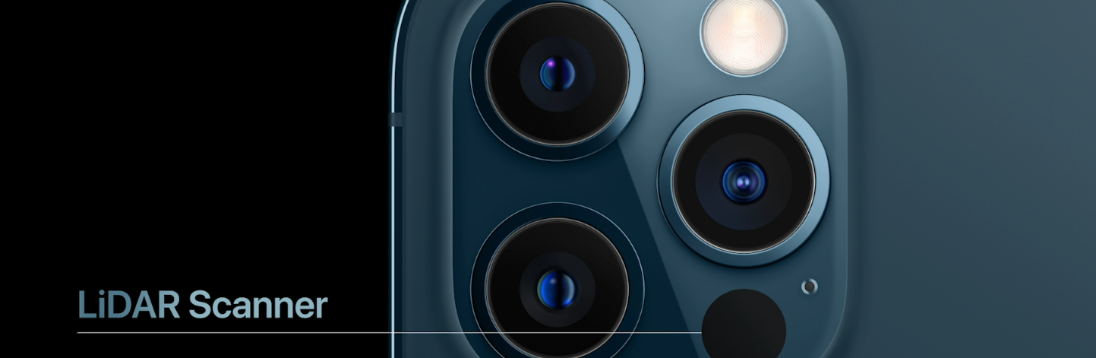

A method for determining ranges
Can be used to make 3D models
Commonly used to make high-resolution maps
Also used in control and navigation in some self-driven cars.
The most famous usage is on iPhone 12 Pro and iPhone 12 Pro Max. It can help designers quickly capture a 3D model of a particular space.

Slide 6

Introduction to the Method of making a
3D model
Here are some methods for making a 3D model of a teacher
Lidar Scanner(Structured Lighting)
3D motion detector (spandex bodysuit type)
3D scanner

Slide 7
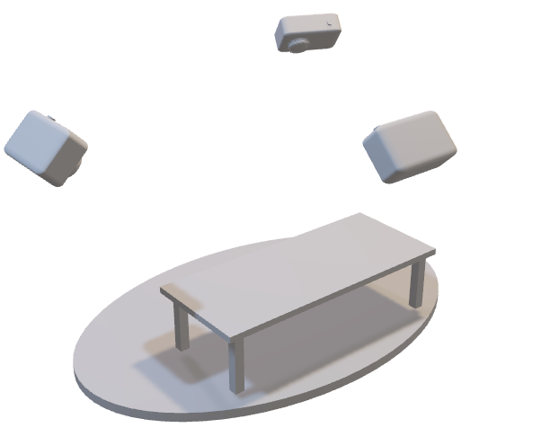
Method of modelling
The lidar or other detectors will be in at least 3 corners detecting the motion of a teacher, including hand and body movements. With a computer, the 3D model can be created easily and fast.
You can try to move the model in edit mode

Slide 8
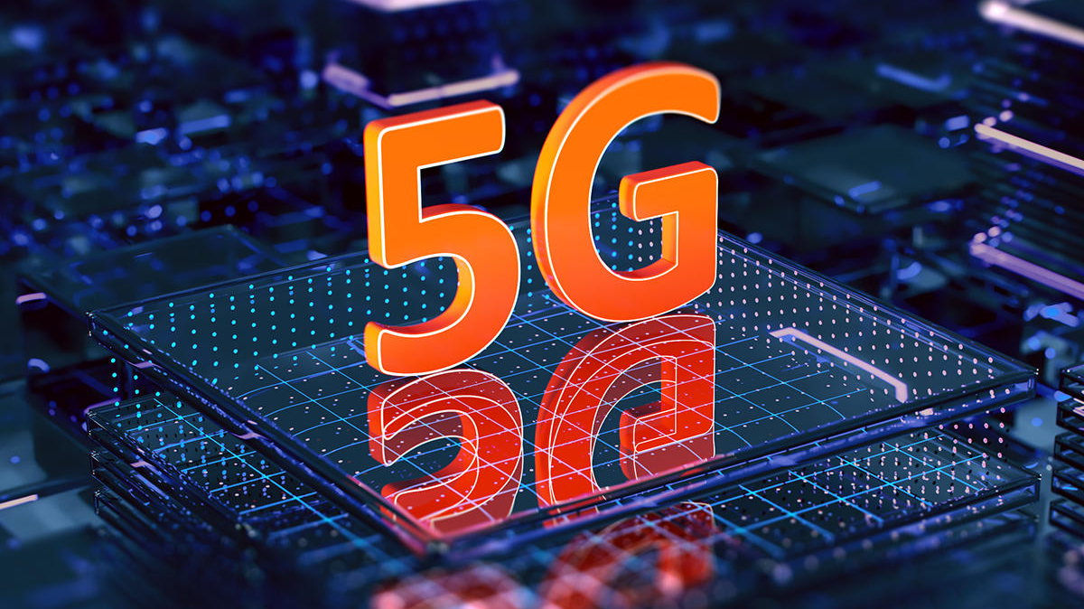
Data transfer
In order not to have a large amount of data, we can model the classroom before having the lesson and then download the model to the client side. We can put the teacher model given by the school to the classroom model in client side’s pc. Then we generate the 2D/3D picture.
The delay of the lesson may be long. Therefore, a 5G network is a necessity to the project. It can ensure the bandwidth and minimal delay for the lesson.

Slide 9
Showing(Client side)
Holographic projection
VR
3D video controlling

Slide 10
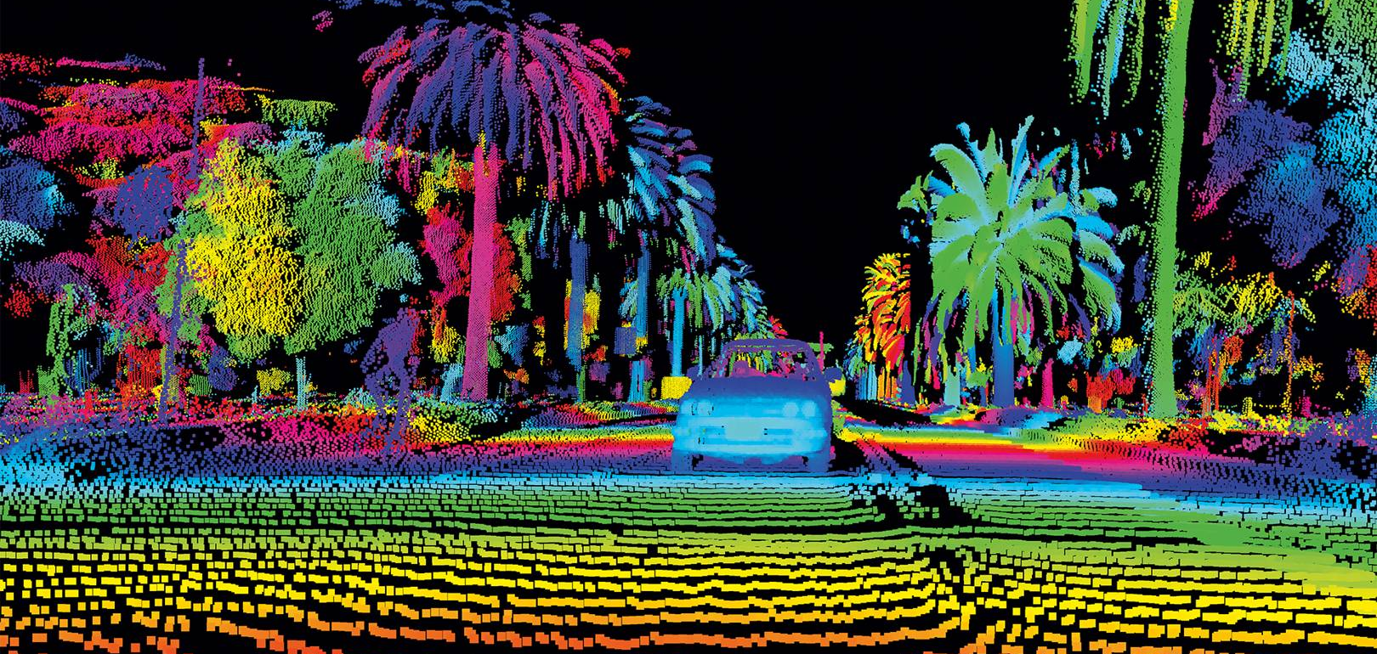
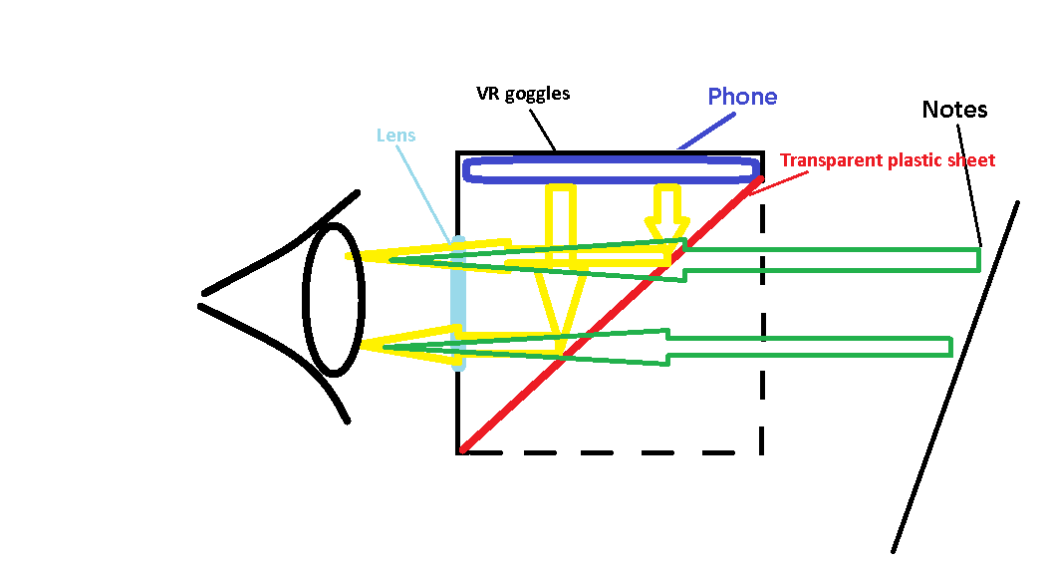
About VR (Virtual Reality)
A simulated experience that can be similar to or completely different from the real world.
Applications of virtual reality include entertainment (e.g. video games) and education (e.g. military training).
Simulation-based, avatar image-based, projector-based, desktop-based
Students can drop notes using this kind of VR goggle lessons

Slide 11
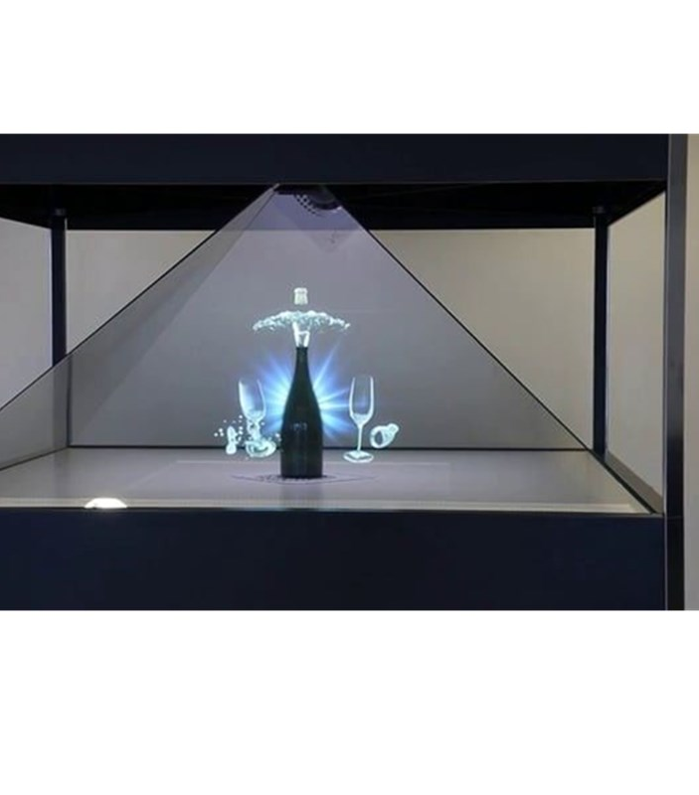
Holographic projection
Using Holographic projection, we can also see the 3D view of the teacher.
The method is also cheap and easy to make
It doesn't require a strong hardware of phone

Slide 12
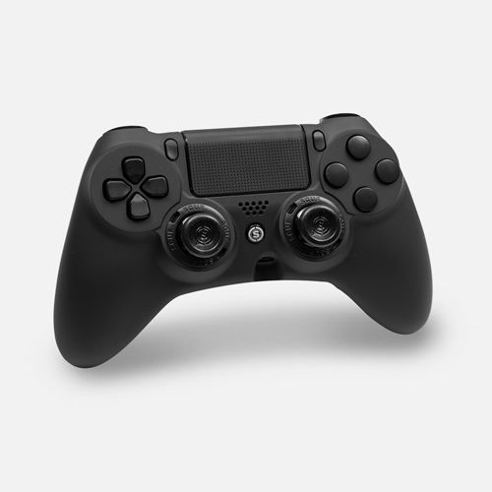
Controlling the View
To see the teacher clearly, students need to control the view as in 3D video games. The controlling method of aerial filming, airplanes, and 3D games are good references for the controlling method.

Slide 13
References
https://wikipedia.org
https://geospatialworld.net
https://www.tinkercad.com/
https://www.youtube.com/
https://www.google.com/
https://www.apple.com/
https://www.xsens.com/
http://www.optoslon.com/
https://www.pubg.com/

Slide 14

Thank you

